Slide 1
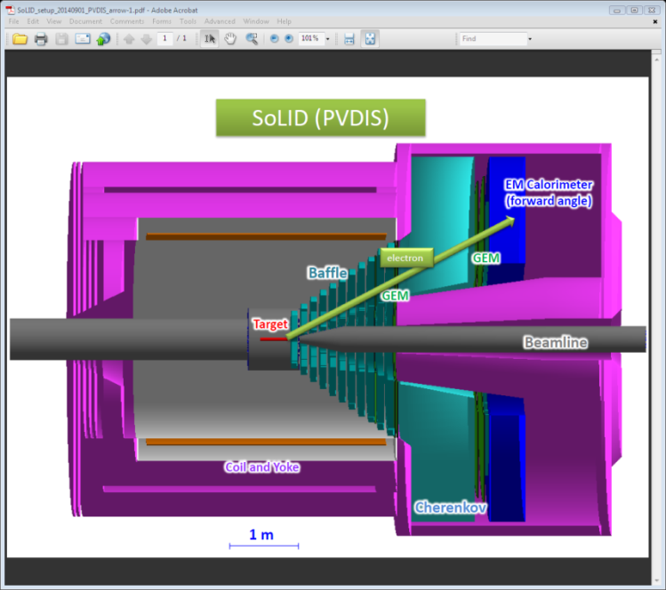
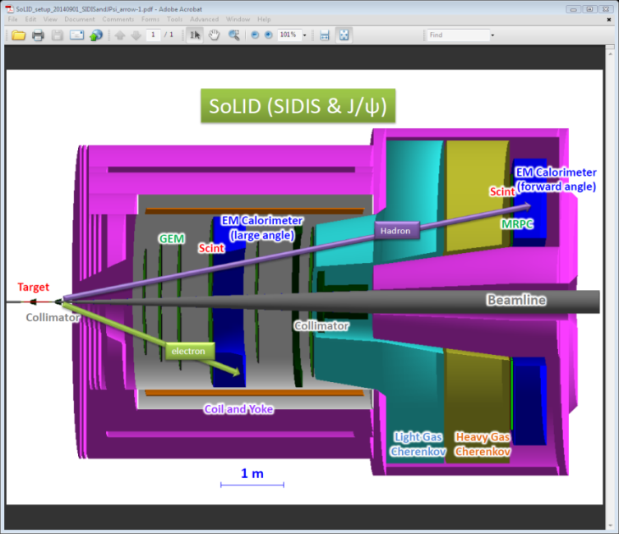
Update from SoLID (Solenoidal Large Intensity Device)
Zhihong Ye
Duke University & SoLID Collaboration
Hall-A Winter Meeting
10/09/2014

Slide 2
Outline
SoLID Overivew
Physics : PVDIS, SIDIS, JPSi
Magnet
Baffle
Detectors
Triggers&DAQ
Simulation and Software
Summary

Slide 3
Overview
Exciting physics topics:
SIDIS: E12-10-006 (A), E12-11-007 (A), E12-11-108 (A), and two new bonus runs
PVDIS: E12-10-007 (A)
J/Psi: E12-12-006 (A-)
and can be more ...
High Intensity (10³⁷ ~ 10³⁹ cm⁻²s⁻¹) and Large Acceptance
Take advantage of new developed detector techniques, data aquisition and close-to-realistic simulation.
Sophesticated MC simulation and analysis software developments
A strong and still expending collaboration:
200+ physicists, 50+ institutions and significant international contributions ...

Slide 4
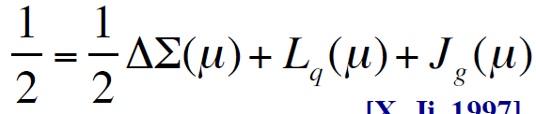
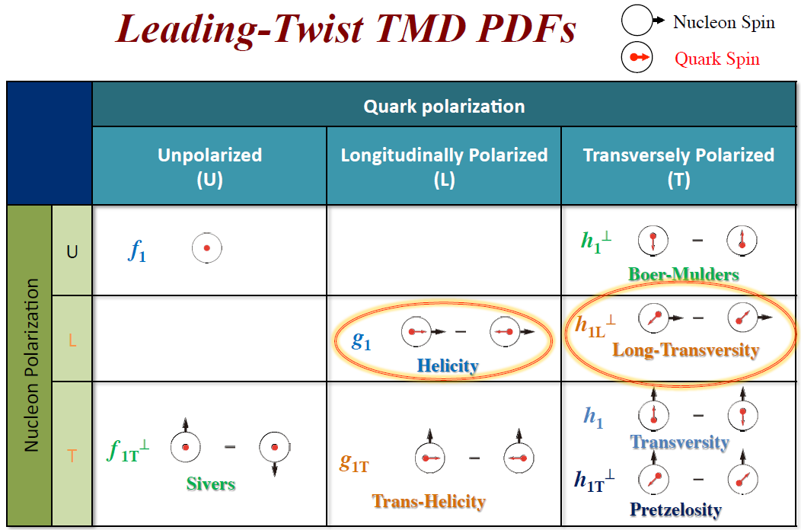
Physics
Semi-Inclusive Deep Inelastic Scattering (SIDIS):
Nucleon Spin Puzzle:
SIDIS: 4-D (x, pt, Q2, z) probes of nucleon
transverse momentum distribution (TMD)

Slide 5
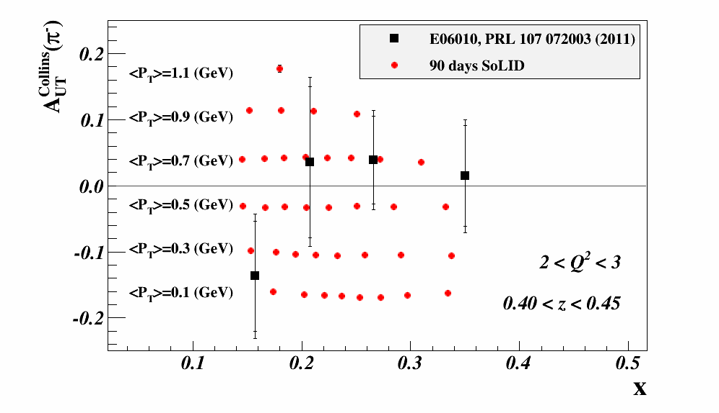
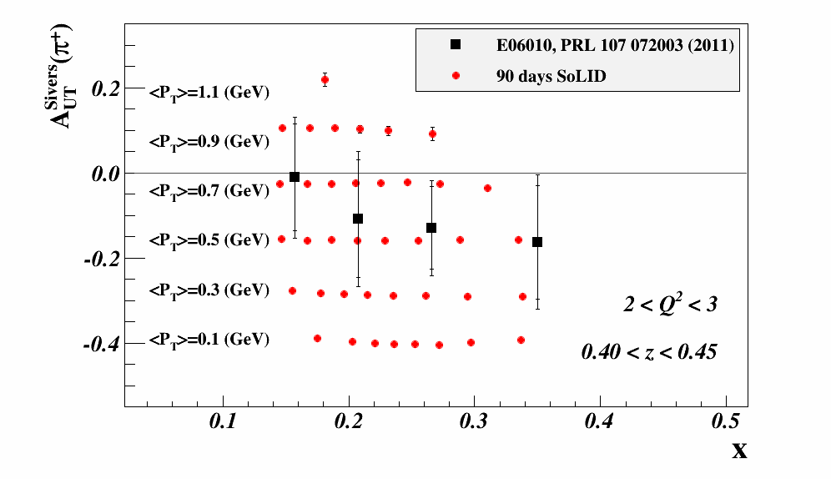
Physics
Semi-Inclusive Deep Inelastic Scattering (SIDIS):
Nucleon Spin Puzzle:
SIDIS: 4-D (x, pt, Q2, z) probe of nucleon
transverse momentum distribution (TMD)
SoLID-SIDIS studies TMDs with extensive coverage and resolutions (48 Q-z bins)
0.3 < z < 0.7
1.0 < Q < 8.0
0.0 < pt < 1.2
0.1 < x < 0.7

Slide 6
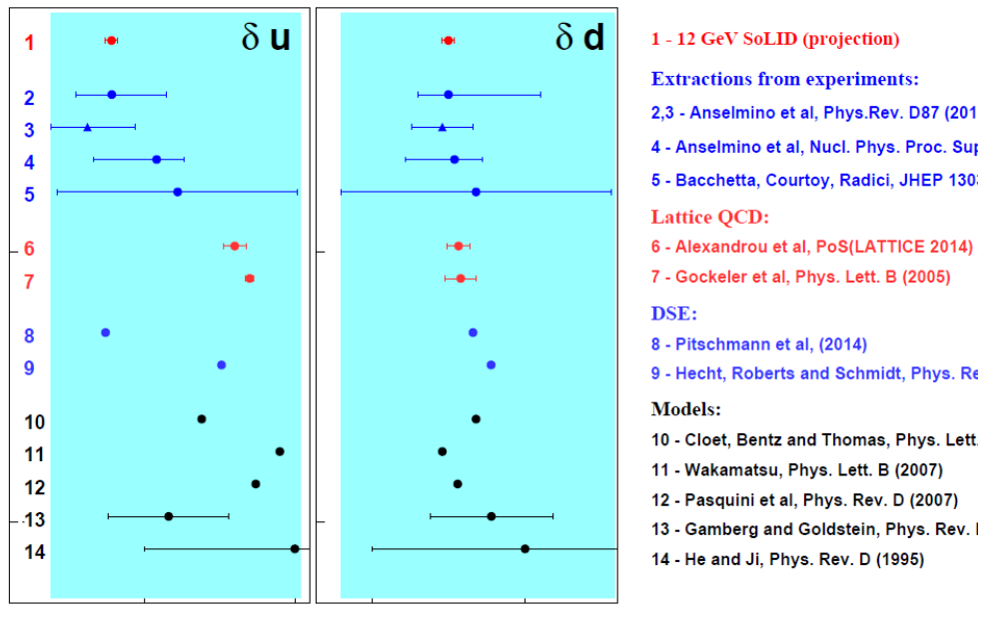
Physics
Semi-Inclusive Deep Inelastic Scattering (SIDIS):
Nucleon Spin Puzzle:
SIDIS: 4-D (x, pt, Q2, z) probe of nucleon
transverse momentum distribution (TMD)
SoLID-SIDIS studies TMDs with extensive coverage and resolutions (48 Q-z bins)
Determine the tensor charge of d & u

Slide 7
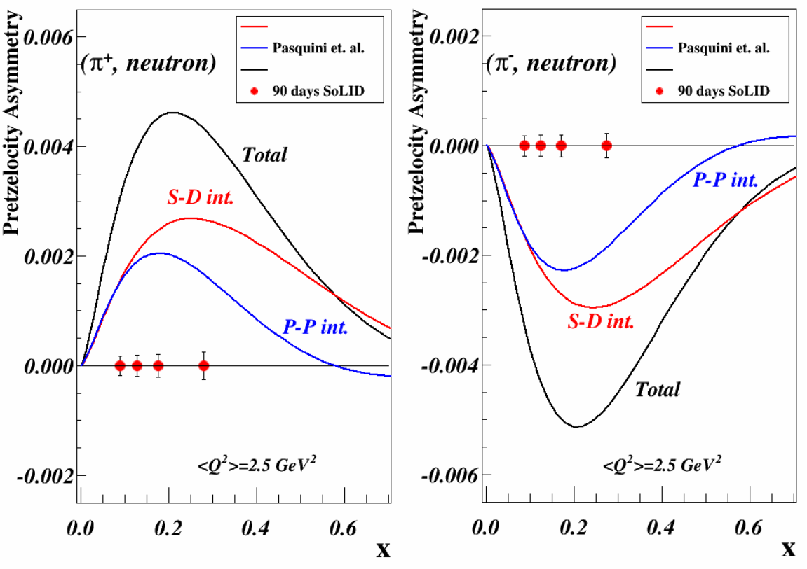
Physics
Semi-Inclusive Deep Inelastic Scattering (SIDIS):
Nucleon Spin Puzzle:
SIDIS: 4-D (x, pt, Q2, z) probe of nucleon
transverse momentum distribution (TMD)
SoLID-SIDIS studies TMDs with extensive coverage and resolutions (48 Q-z bins)
Determine the tensor charge of d & u
Access the orbital angular momentum (OAM) of quarks and gluons with transverse n/p

Slide 8
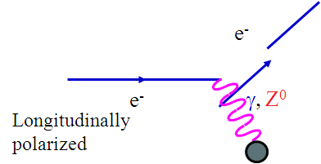
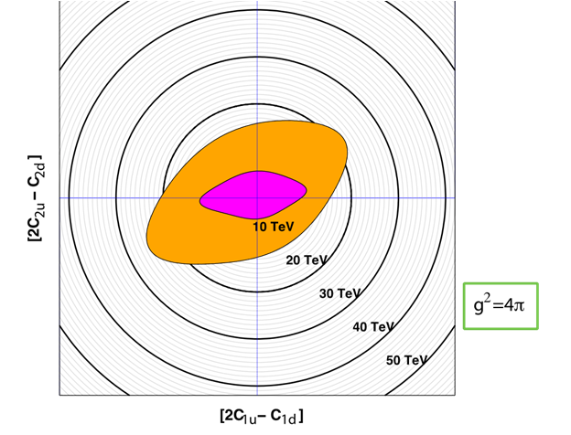
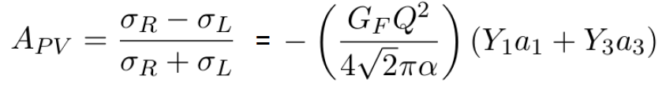
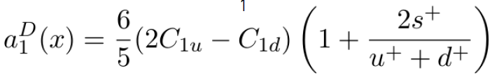
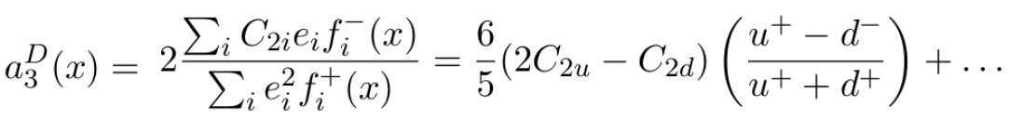
Physics
Parity Violation Deep Inelastic Scattering (PVDIS):
Measure the asymmetry between left- and right-handed electrons can access:
QCD: nucleon structure, charge asymmetry,
high twist, EMC ...
Electro-Weak
New physics in NP and HEP
(TeV-scale probe ...)
More ...
SoLID-PVDIS
6GeV-PVDIS
New physics

Slide 9
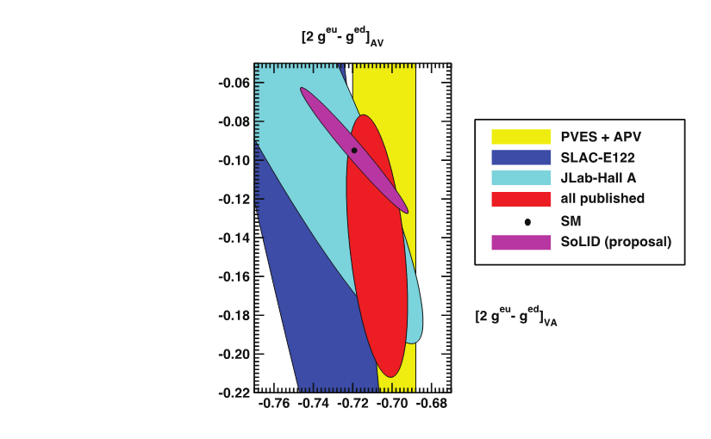
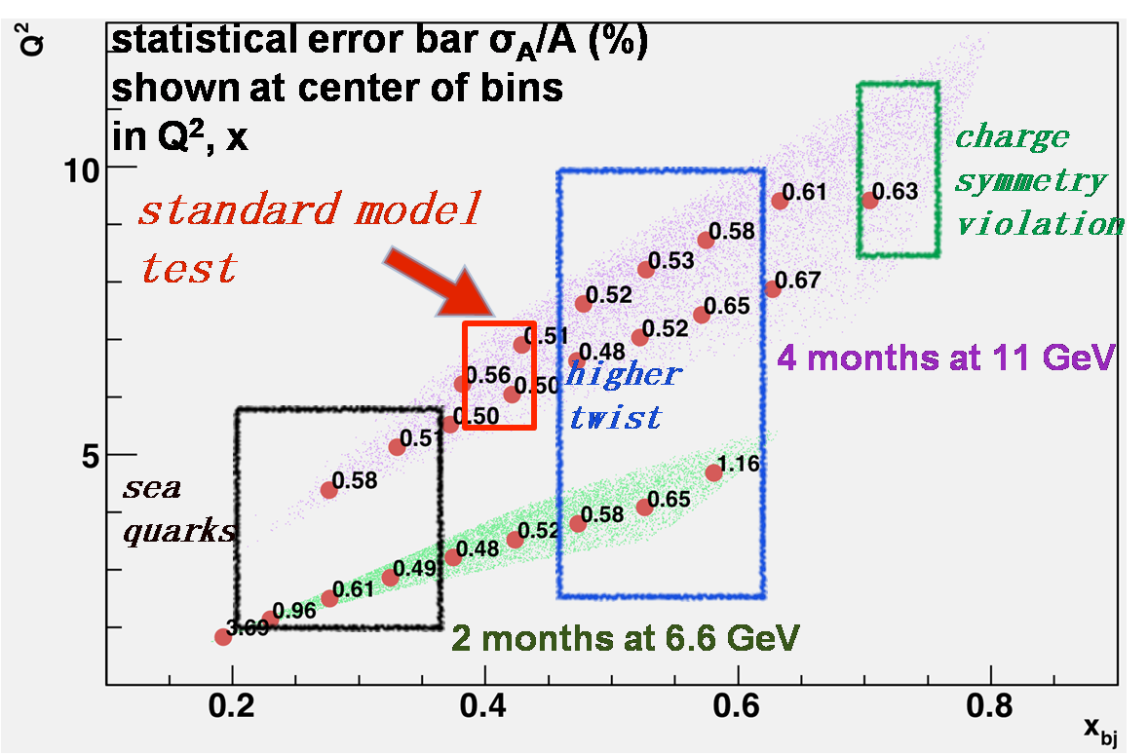
Physics
Parity Violation Deep Inelastic Scattering (PVDIS):
Measure the asymmetry between left- and right-handed electrons can access:
QCD: nucleon structure, charge asymmetry,
high twist, EMC ...
Electro-Weak
New physics in NP and HEP
(TeV-scale probe ...)
More ...
→ SoLID-PVDIS: measures LH2 and LD2 with 1% error

Slide 10
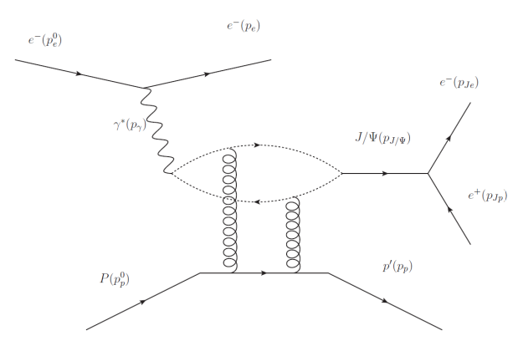
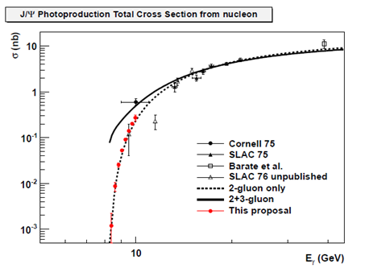
Physics
Near Threshold Electroproduction of J/Psi
Probes strong gluonic interaction between two color
neutral objects J/ψ and nucleon near threshold
Trace Anomaly
Gluon Energy
Multiple gluon exchange may cause enhancement near threshold
Quark Energy
Quark Mass
Trace anomaly of QCD energy momentum tensor plays an essential part in proton mass budget
Models relate J/ψ production near threshold to trace
anomaly and proton mass budget
(D. Kharzeev et al Eur.Phys.J. C9 459 (1999), A. Sibirtsev et al. Phys. Rev., D71:076005 (2005))

Slide 11
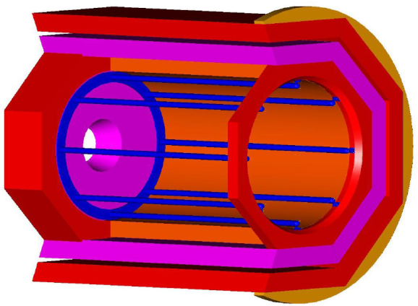
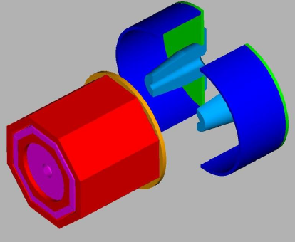
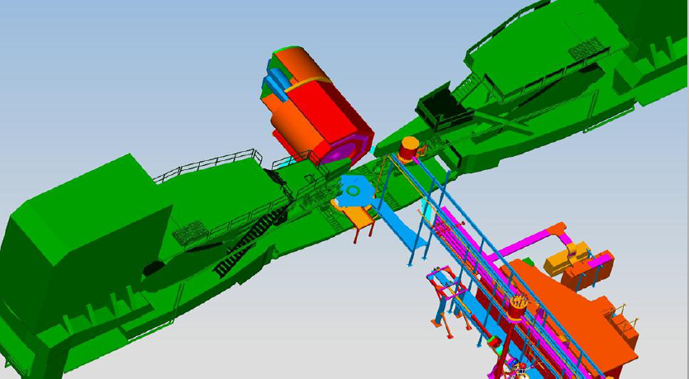
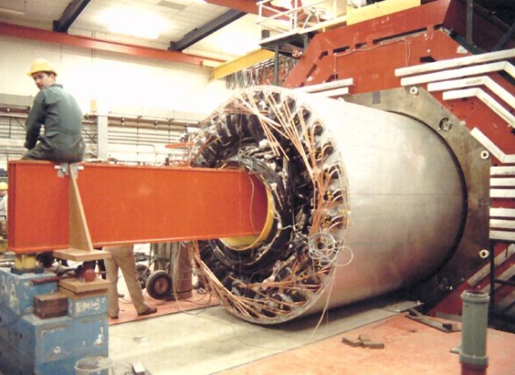
Magnet
CLEO-II Solenoid Magnet: from Cornell Univ.
Goals:
→Acceptance: Φ: 2π, θ: 8º-24º (SIDIS), 22º-35º (PVDIS),
P: 1.0 – 7.0 GeV/c,
→ Resolution: δP/P ~ 2% (requires 0.1 mm tracking resolution)
→ Fringe field at the front end < 5 Gaus
Status:
→ CLEO-II magnet formally repqested and agreed in 2013:
Built in 1989 and operated until 2008, uniform central field at 1.5 T,
Inner radius 2.9 m and coil radius 3.1 m
→ Site visit in 2014, disasembly in 2015 and plan transportation in 2017
→ Design of supporting structures and mounting system at JLab
CLEO in Hall-A

Slide 12

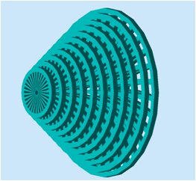
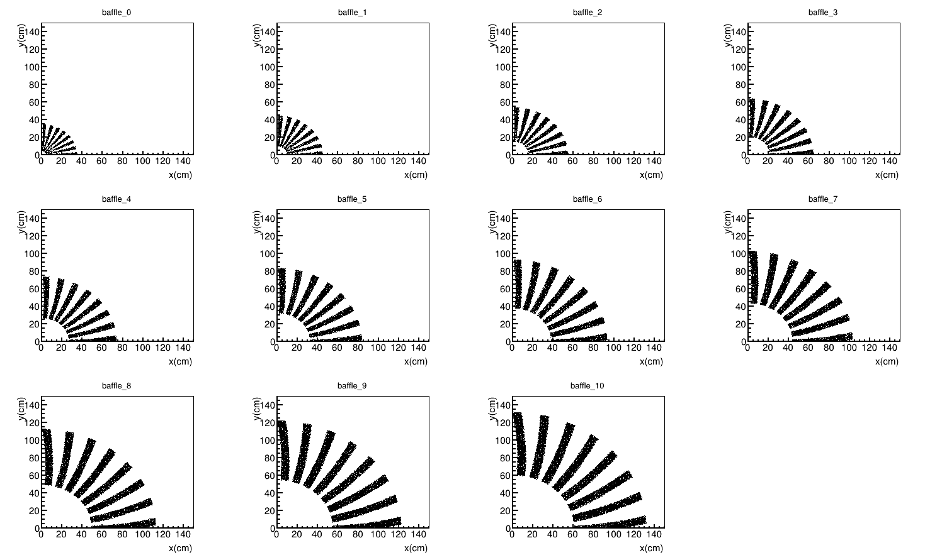
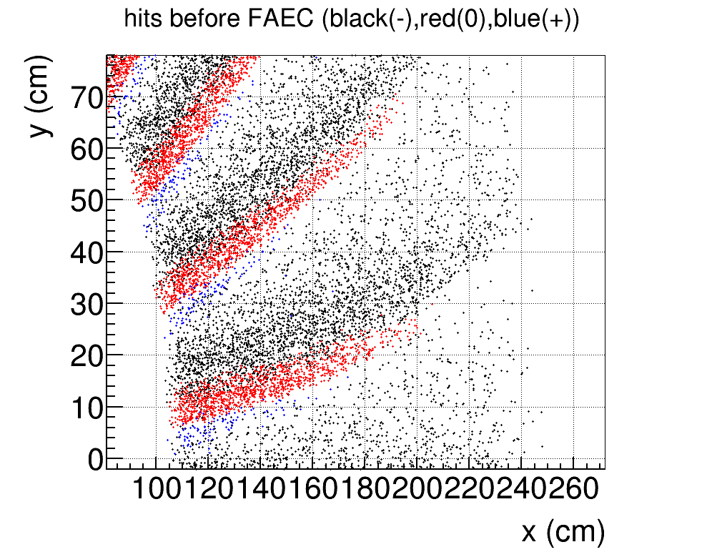
Baffle
PVDIS Baffle:
Goals:
→ For PVDIS only
→ 11 layers of 9cm thick lead and one layer of 5cm lead
→ Right after the target to block photons, pions and secondary particles.
→ Follow charge particle bending in the field, preserve the same azimuthal slice and block line of sight.
1st
1nd
3rd
4th
12th
5th
6th
7th
8th
9th
10th
11th

Slide 13
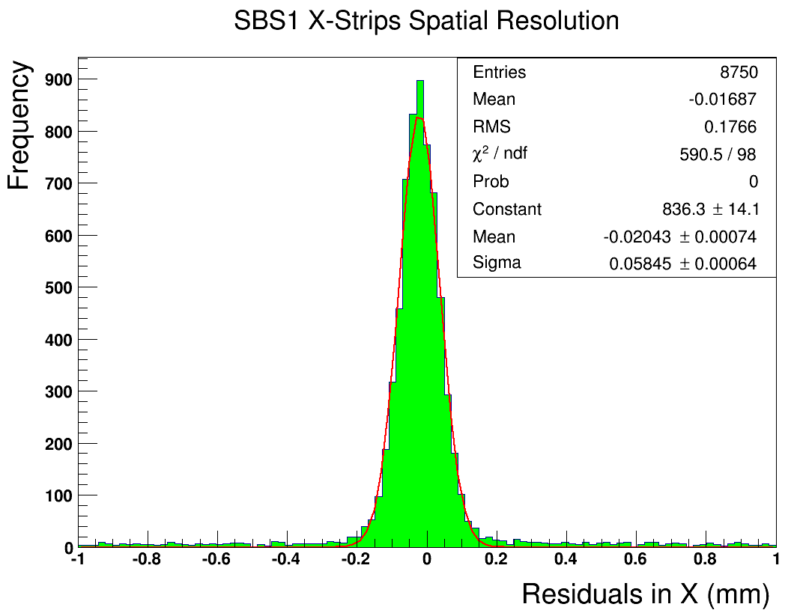
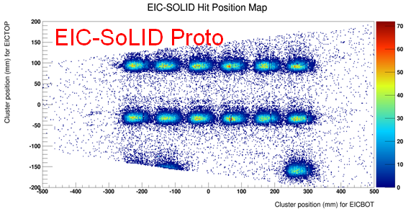
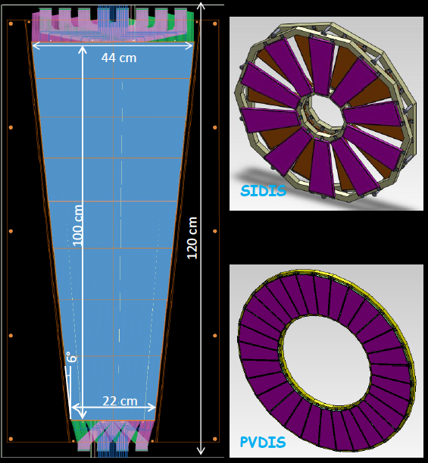
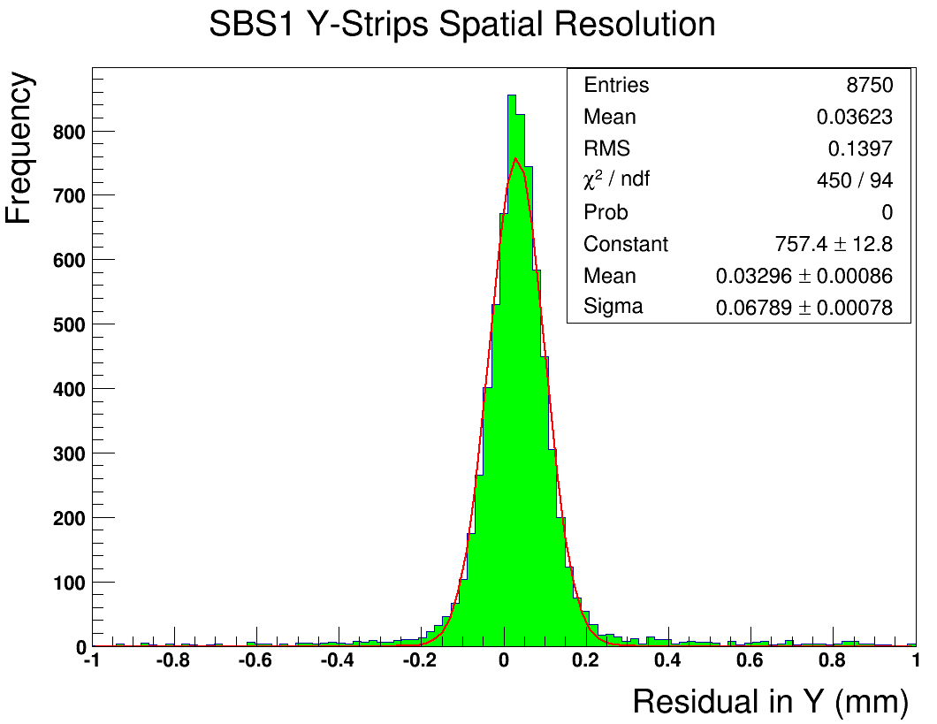
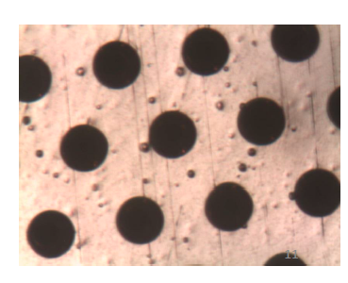
Detectors
GEM: by UVa and Chinese collaborators
Goals: →5 planes (PVDIS) and 6 planes (SIDIS/Jpsi), area~37 m² (165K outputs),
→tracking eff.>90%, radius resolution ~ 0.1 mm,
→work in high rate and high radiation environment.
Status:
UVa: First full size prototype assembled, and beam test at
Fermi Lab
σ_{X} = 58 μm
σ_{Y}=67 μm
China: CIAE/USTC/Tsinghua/LZU)
30x30 cm prototype constructed and readout tested,
Gem foil production facility under development at CIAE
GEM foils made at CIAE

Slide 14
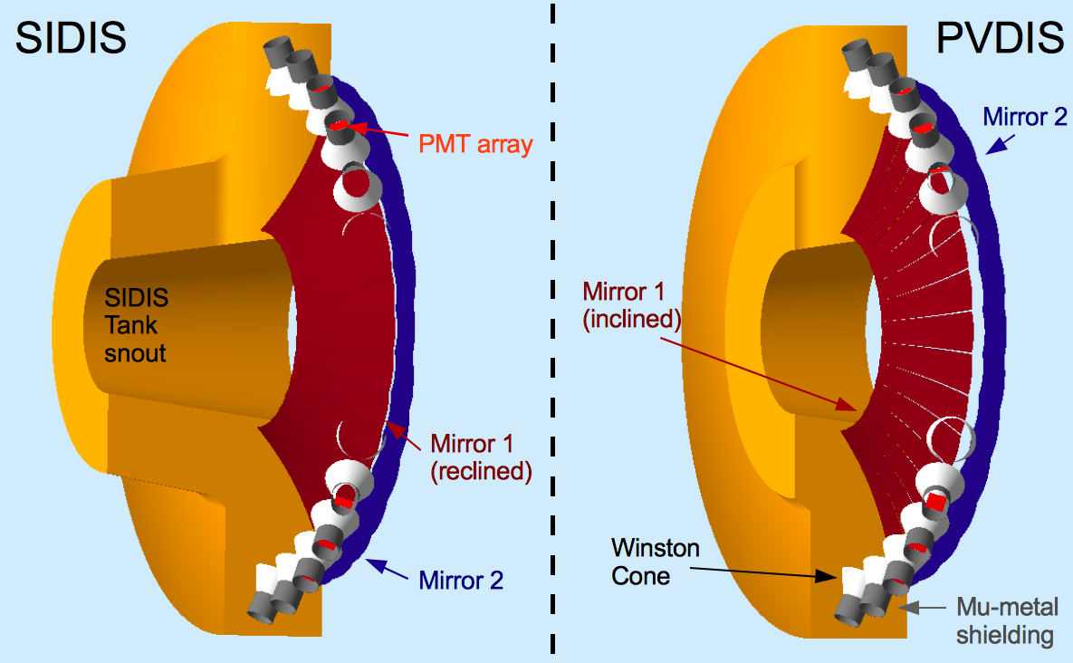
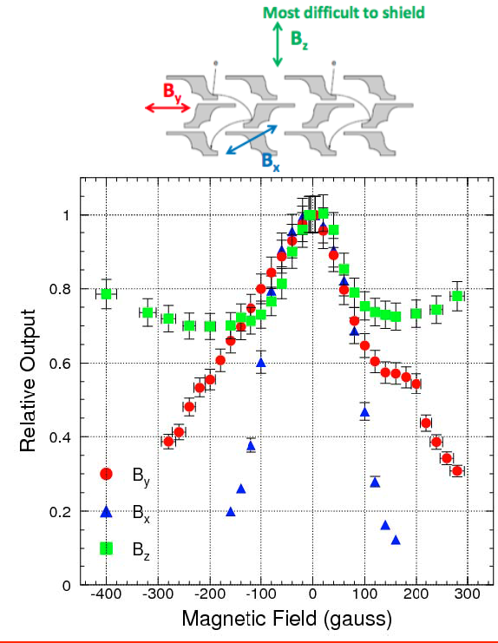
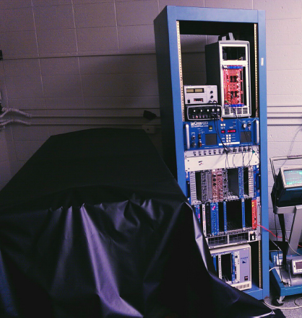
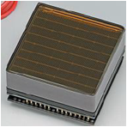
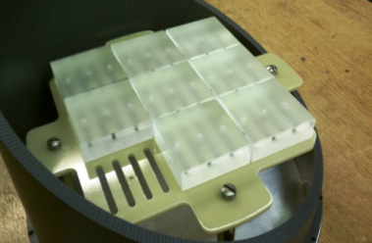
Detectors
Light Gas Cherenkov Counter (LGC): by Temple University
Goals:
→2 m C02 (SIDIS/Jpsi), 1 atm
→1 m C4F8O (65%)+N2 (35%) (PVDIS), 1 atm
→30 sectors, 60 mirrors, 270 PMTs,
Area~20m²
→N.P.E>10, eff.>90%, π suppresion > 500:1
→Work at 200G field (100G after shielding)
Magnet field test with MaPMT
(S. Malance, JINST 8 P09004,2013)
Status:
→ Support Structure and Mounting Design
→ u-metal Shielding design
→ Pre-R&D

Slide 15
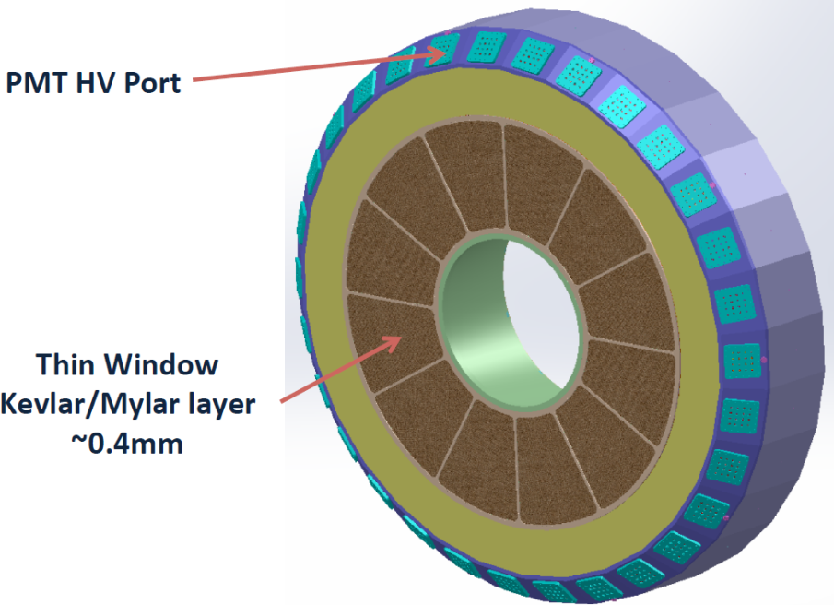
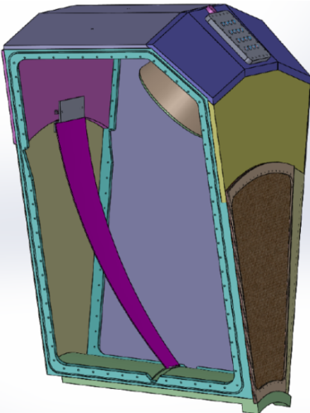
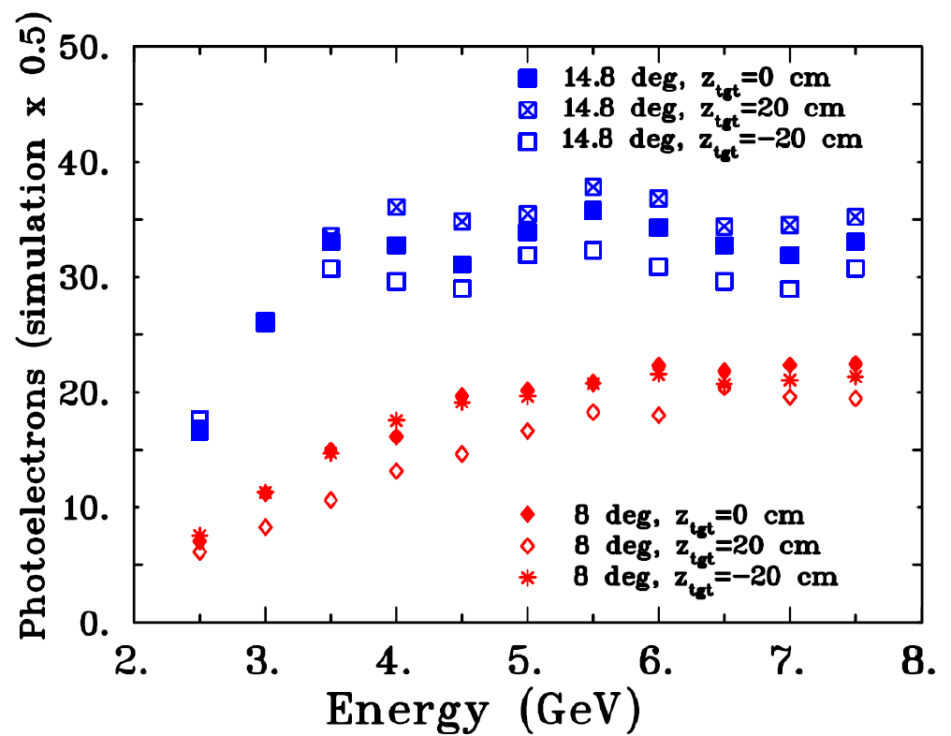
Detectors
Heavy Gas Cherenkov Counter (HGC): by Duke University
Goals:
→for SIDIS only
→1 m C4F8O at 1.5 atm
→30 mirrors, 480 PMTs, area~20 m²
→N.P.E>10, eff.>90%, Kaon suppresion > 10:1,
→Work at 200G field (100G after shielding)
Status:
→ Designs of Support Structure,
Mounting, Shielding, etc.
→ Prototype-Test will happen at Duke soon

Slide 16

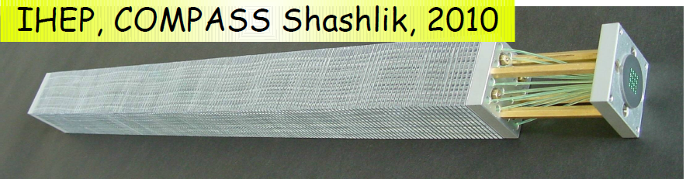

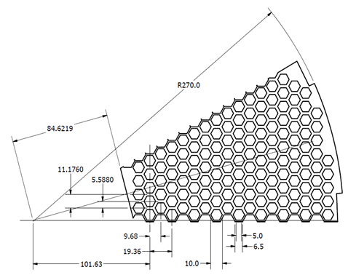
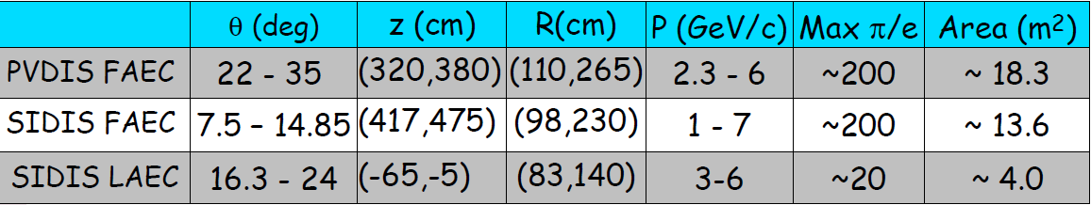
Detectors
Electromagnetic Calorimeters (EC): by UVa and ...
Goals:
→ Shashlyk sampling calorimeters
→ PreShower: 1800 modules (2 R.L.)
Shower: 1800 modules (18 R.L)
300 scintillator pedal detectors in front
30 sectors, area~100 m²
→ Modules re-arranged for PDVIS<->SIDIS
→ electron eff.>90%, E-Resolution~10%/√E
π suppresion > 50:1, Photon Rejection 5:1
→ Rad. Hard (<20% descreasing after 400K Rad)

Slide 17
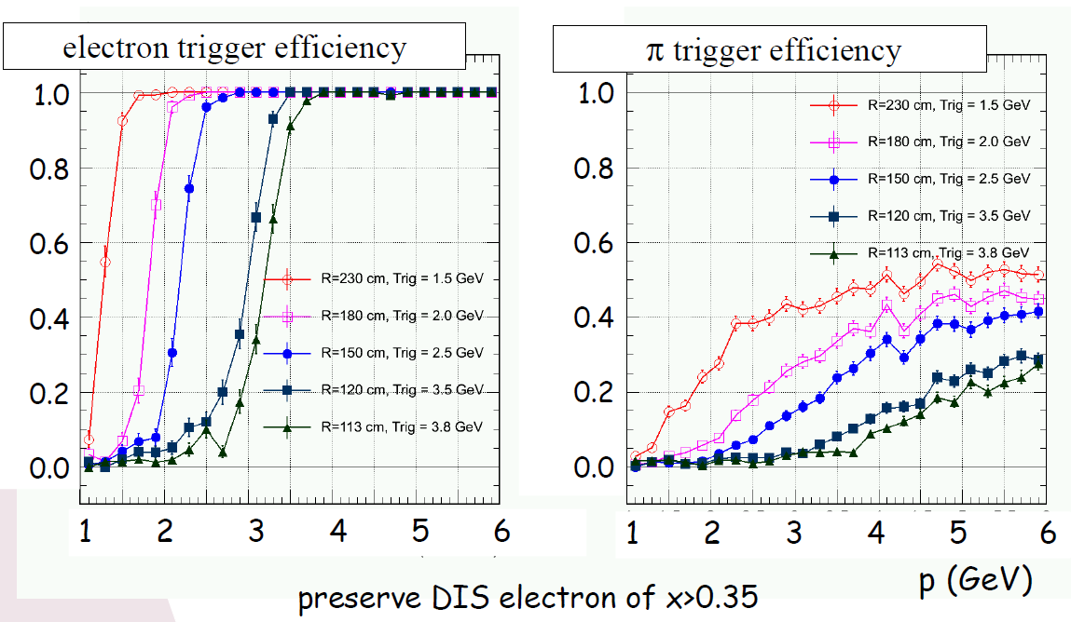
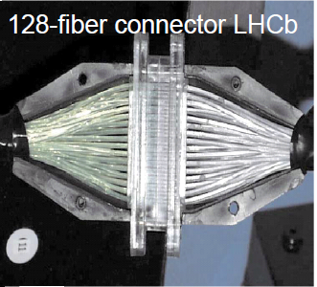
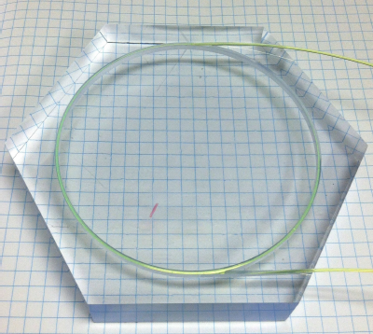
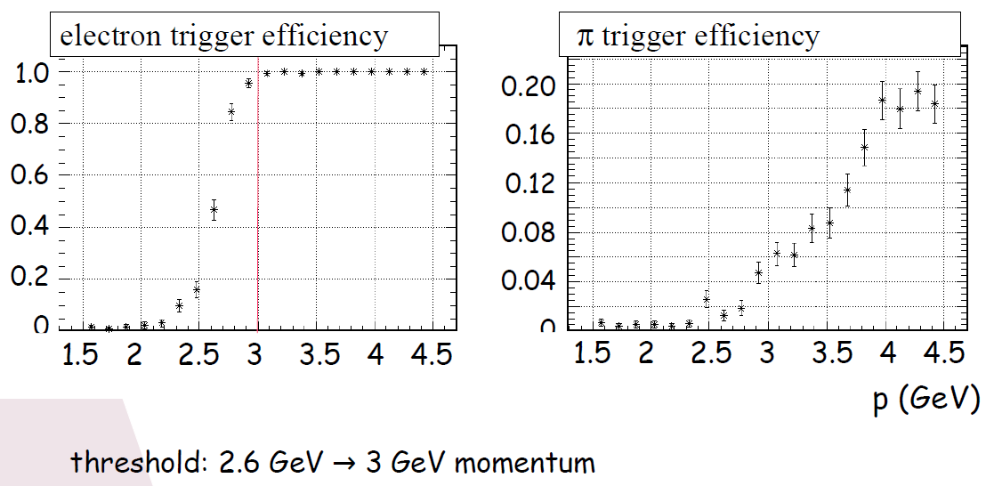
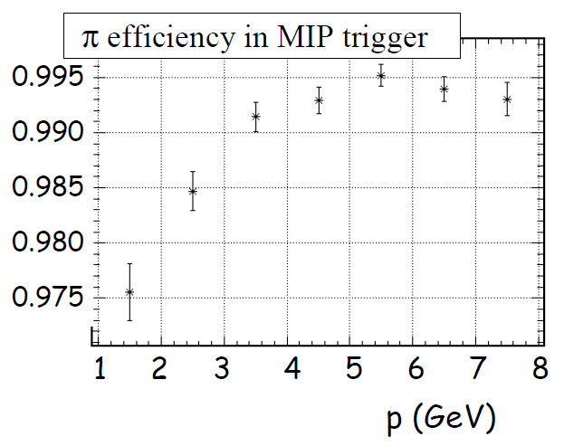
Detectors
Electromagnetic Calorimeters (EC): continue ...
PVDIS
Status:
→ Sophesticated Geant Simulation
→ Pre-R&D at UVa and JLab
SIDIS (worse case)

Slide 18
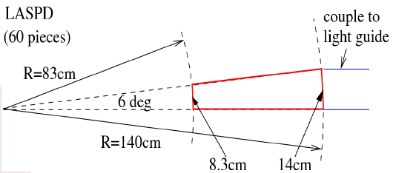
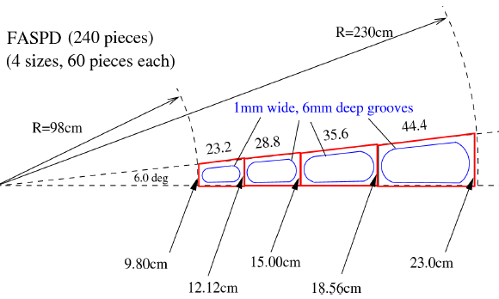
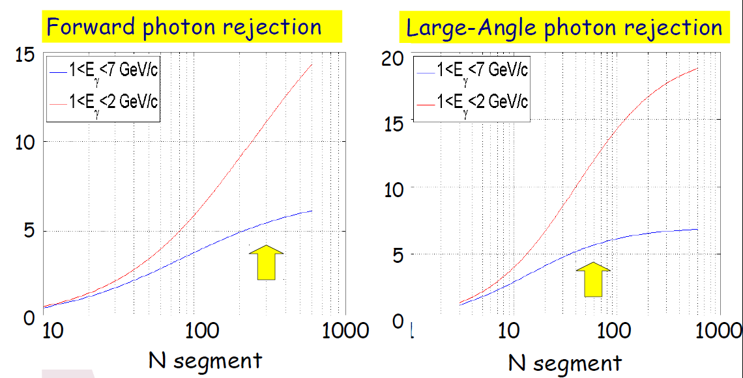
Detectors
Scintillating Pedal Detectors (SPD): by UVa and ...
Goals:
→ For SIDIS only
→ Two planes (in front of LAEC and FAEC):
LASPD: 60 modules, 5 mm or thicker, photon rej. 10:1
FASPD: 60 modules x 4 radius, photon rej. 5:1
→ LASPD timing resolution < 150ps
Status:
→ Sophesticated Geant Simulation
→ Pre-R&D at UVa and JLab

Slide 19
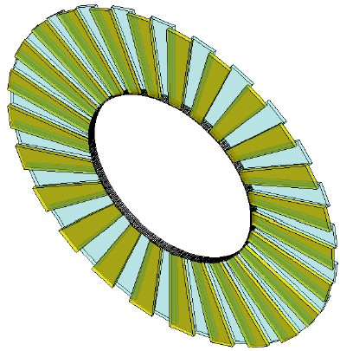
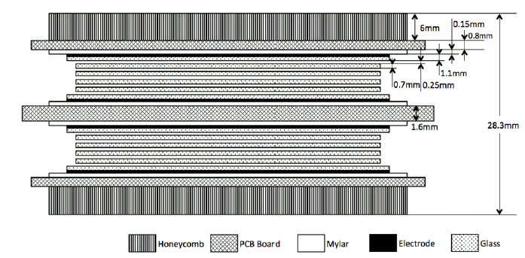




Detectors
Multi-gap Resistive Plate Chamber: by Tsinghua and Rutgers
Goals:
→ For SIDIS only, between FASPD and FAEC
→ 50 super-modules, each contains 3 modules,
1650 strips and 3300 output channels.
→ Timing resolution < 100ps
→ Works at high rate up to 10 KHz/cm2
→ Photon suppression > 10:1
→ π/k separation up to 2.5GeV/c
Status:
→ Prototype Developed at Tsinghua
→ Beam test at Hall-A

Slide 20

Triggers&DAQ
Triggers:
Estimation based on sophesticated Geant simulation and well-tone physics models
PVDIS: LGC+EC provide electron triggers, 27 KHz/sector, 30 sectors
SIDIS: Coincident trigger between electrons and hardrons within a 30 ns window:
LASPD+LAEC provide electron triggers, 25 KHz
LGC+FASPD+MRPC+FAEC provide electron trigger, 129 KHz
FASPD+MRPC+FAEC provide hardron trigger, 14 MHz
→ Read out EC clusters to reduce background
66 KHz + 6 KHz (eDIS)
EC Trigger
Data Aquisition System:
→ Use fast electronics to handle the high luminosity
(FADC, APV25, VETROC, etc.)
→ Current design can handel trigger rates up to
60 KHz per sector
→ Use Level-3 to further reduce the events size
→ Learn from Hall-D

Slide 21


Simulation&Software
GEMC:
SoLID full setup in GEMC (Geant4) with realistic materials
EM background produced from 11GeV e- on targets with the physics models in Geant4
Hadron background, generated from event generators (Wiser fit) on both target and target windows, then passed into GEMC
No field case
GEM Tracking Reconstruction:
Reconstruct charged particles traveling in the strong magnetic filed
Fast processing time for high rates with backgrounds
Two approaches: Tree Search, Progressive Tracking

Slide 22
Summary
High rated experiments with exciting physics topics
Take advantage of latest detector and electronics techniques
Active MC simulation, software deveoptments and Pre-CDR & Prototyping
CLEO-II magnet has been requested and will be transported in 2017
Pre-conceptial Design Report has been submited in 2014
White-papers submited for QCD and Symmetry town-meetings, and
receipted very positive feekbacks.
Ready for the director review in 2015

Slide 23
Backup Slides

Slide 24

L1 Trigger Diagram
CPU
SSP
SSP
SSP
SSP
SSP
SSP
GTP
SD
SSP
SSP
SSP
SSP
SSP
SSP
SSP
TI
CPU
TD
TD
TD
TD
TD
TD
SD
SD
TD
TD
TD
TD
TD
TD
TS
TS
SSP
VXS Crate
VXS Crate
Sub-System Processor
Consolidates multiple crate subsystems
Report total energy or hit pattern to GTP
Copper Ribbon Cable
32 bit @ 250 MHz: 8 Gbps
CPU
FADC
FADC
FADC
FADC
FADC
FADC
CTP
CTP
SD
FADC
FADC
FADC
FADC
FADC
FADC
TI
Global Trigger Processor
Collect L1 data from SSPs
Calculate trigger equations
Transfer 32 bit trigger pattern to TS
VXS Serial Link
32 bit @ 250 MHz: 8 Gbps
VXS Crate

Slide 25
Level-1 Trigger Electronics
Front-End Crate
Trigger Distribution Crate
Custom Designed
Boards at JLAB
VXS Crate
VXS Crate
Detector
Signals
TD
TS
Fiber Optic Links
Clock/Trigger
(16bits @ 62.5MHz
TS
(16)
(12)
(1)
(1)
(1)
(1)
(1)
VXS Crate
( ) – Number in parentheses
refer to number of modules
Fiber Optic Link
(~100 m)
(64bits @ 125 MHz)
SSP
GTP
fADC250
(8)
CTP Crate Trigger Processor
(2)
(1)
Copper Ribbon Cable
(~1.5 m)
(32bits @ 250 MHz)
SD Signal Distribution
Global Trigger Crate
TI Trigger Interface
Trigger Latency ~ 3 μs
Pipelined detector readout electronics:
fADC
VXS Backplane

